Slide 1
Using Artificial Intelligence Apps to Enhance Learning
Ching Chi Cheung
Assistant Principal
Fukien Secondary School Affiliated School

Slide 2
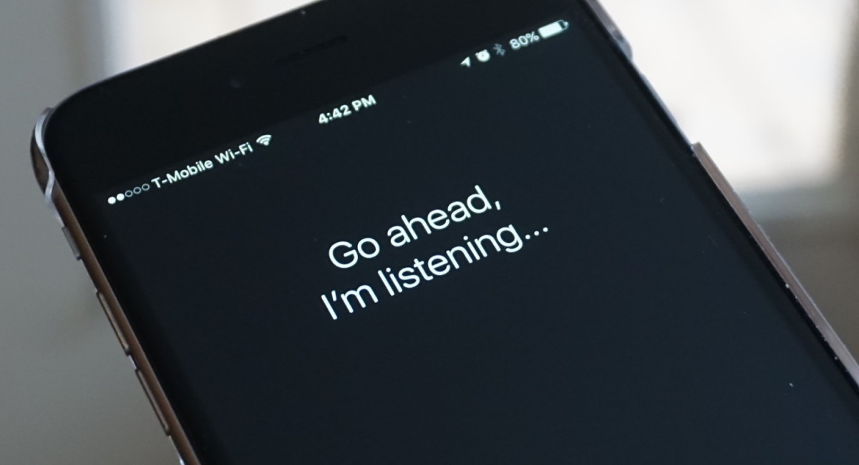
Applications of Artificial Intelligence
Virtual Personal Assistant

Slide 3
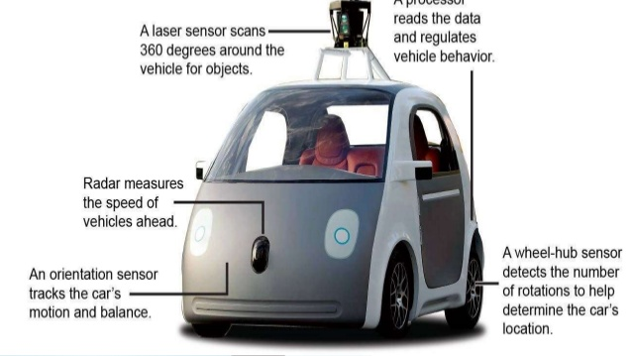
Applications of Artificial Intelligence
Smart cars

Slide 4
Applications of Artificial Intelligence
Purchase Prediction

Slide 5
Applications of Artificial Intelligence
Online Customer Support

Slide 6
MYOB
Make Your Own Bots

Slide 7
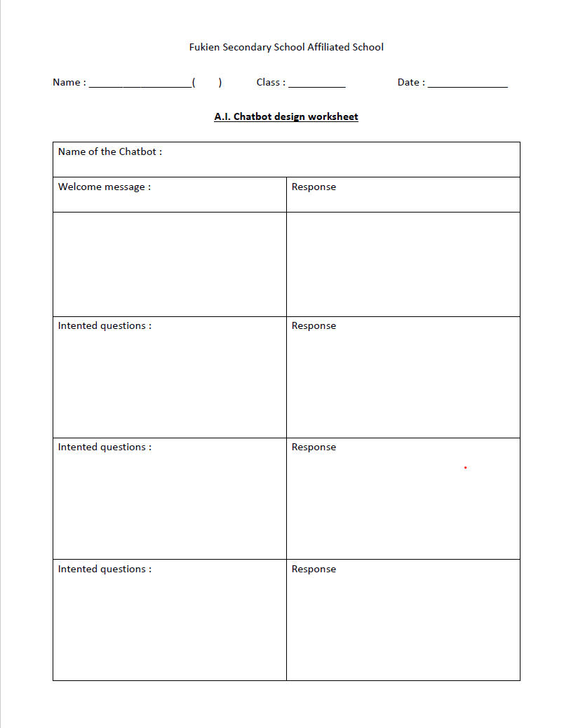

Slide 12
ChatFuel

Slide 17
AI Robot learns English

Slide 18
Project idea:
Through a game, primary school students will use their English knowledge to help teach the robot. Through testing the robot, we can also judge the English level of the primary school students.

Slide 19
Result:
Consolidate the English ability of primary school students
Improve primary students motivation and interest in learning English
Each students different English level will result in unique AI robots
Through repeated errors and corrections during teaching, primary school students will understand the difficulty of teaching English
······

Slide 20
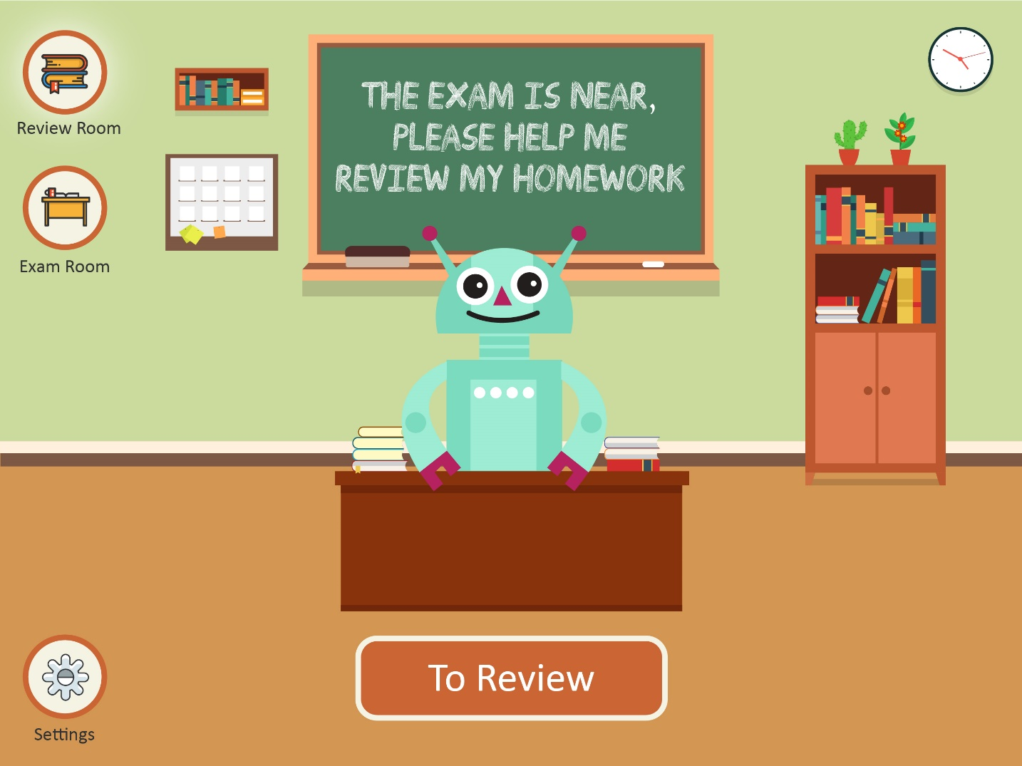
Function Module – Review
In the review room, the students mentor the robot in word detection

Slide 21
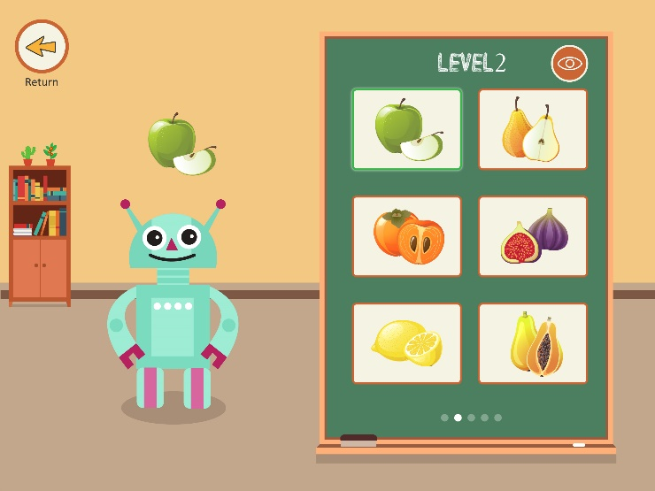
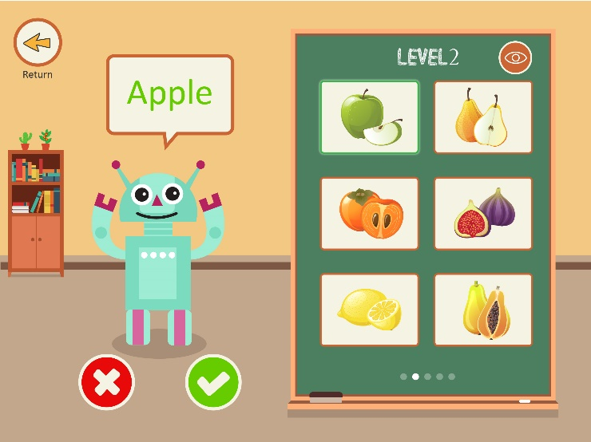
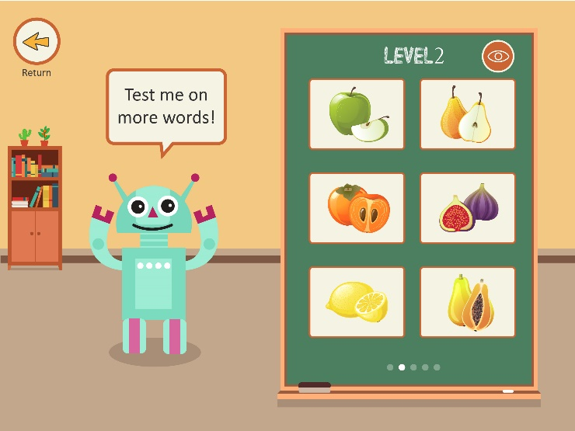
Review Process – Choose a card
Click on a card on the right– wait for the robot to answer
The student will judge the answer
*You can check the corresponding words at any time
1
2
3
4

Slide 22
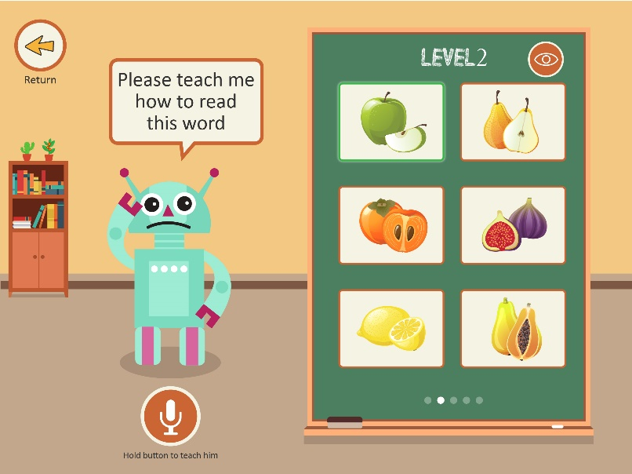
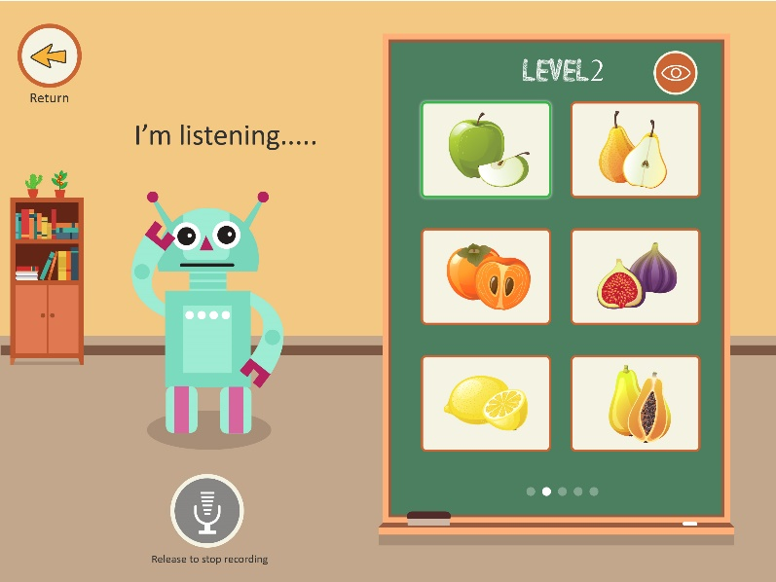
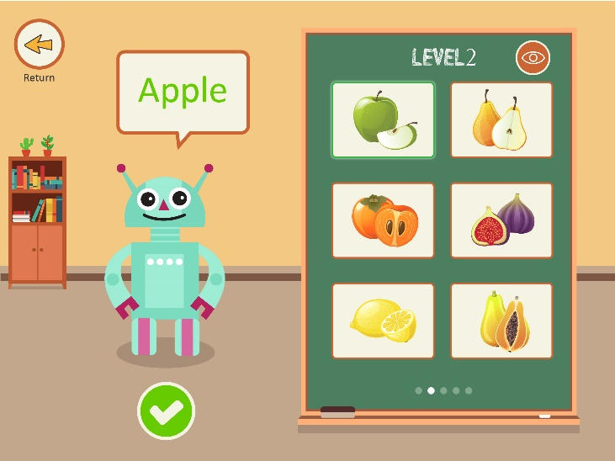
Review process – Correct mistakes
Student reads the correct word using a microphone
After the robot repeats the word, the student will confirm（improving the robots memory）
* You can check the corresponding words at any time
1
2
3

Slide 23
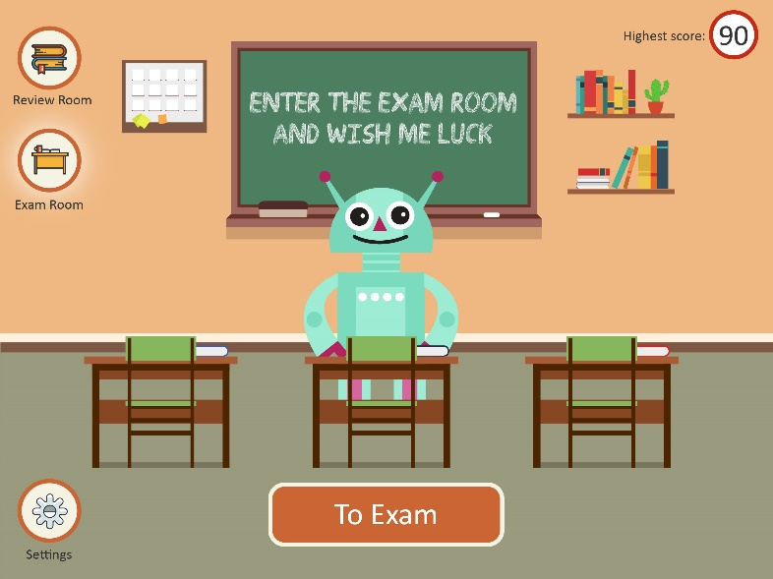
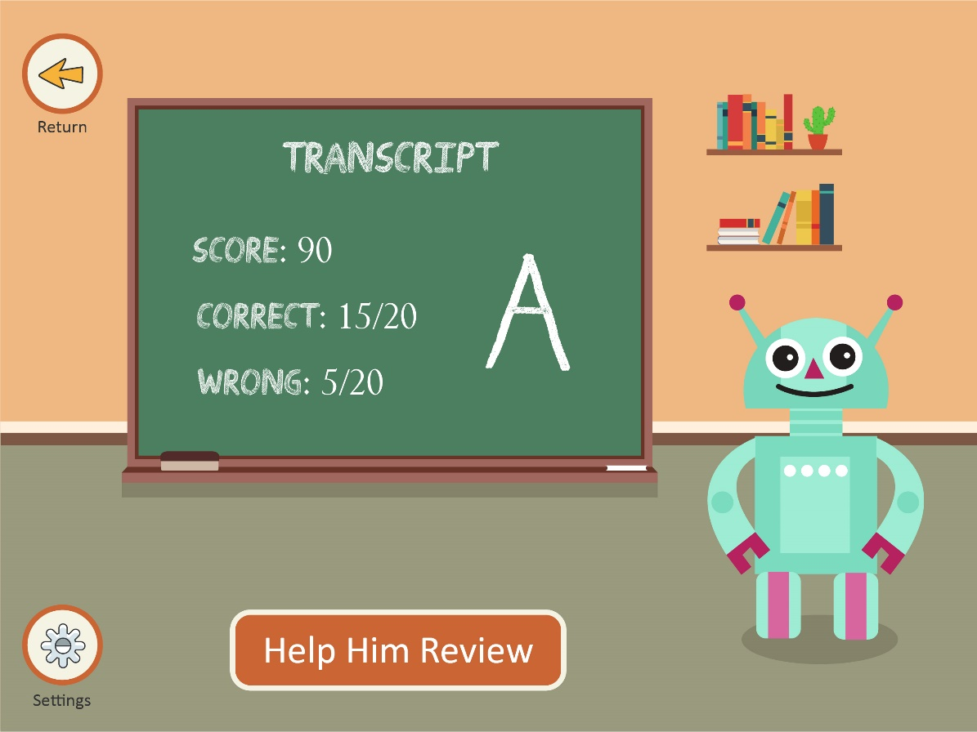
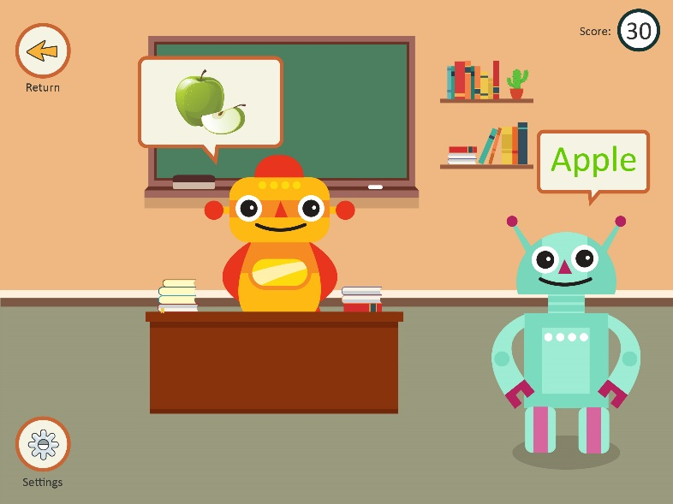
Functional module – Exam
Enter exam room, test the robot's learning progress and record the highest score

Slide 24
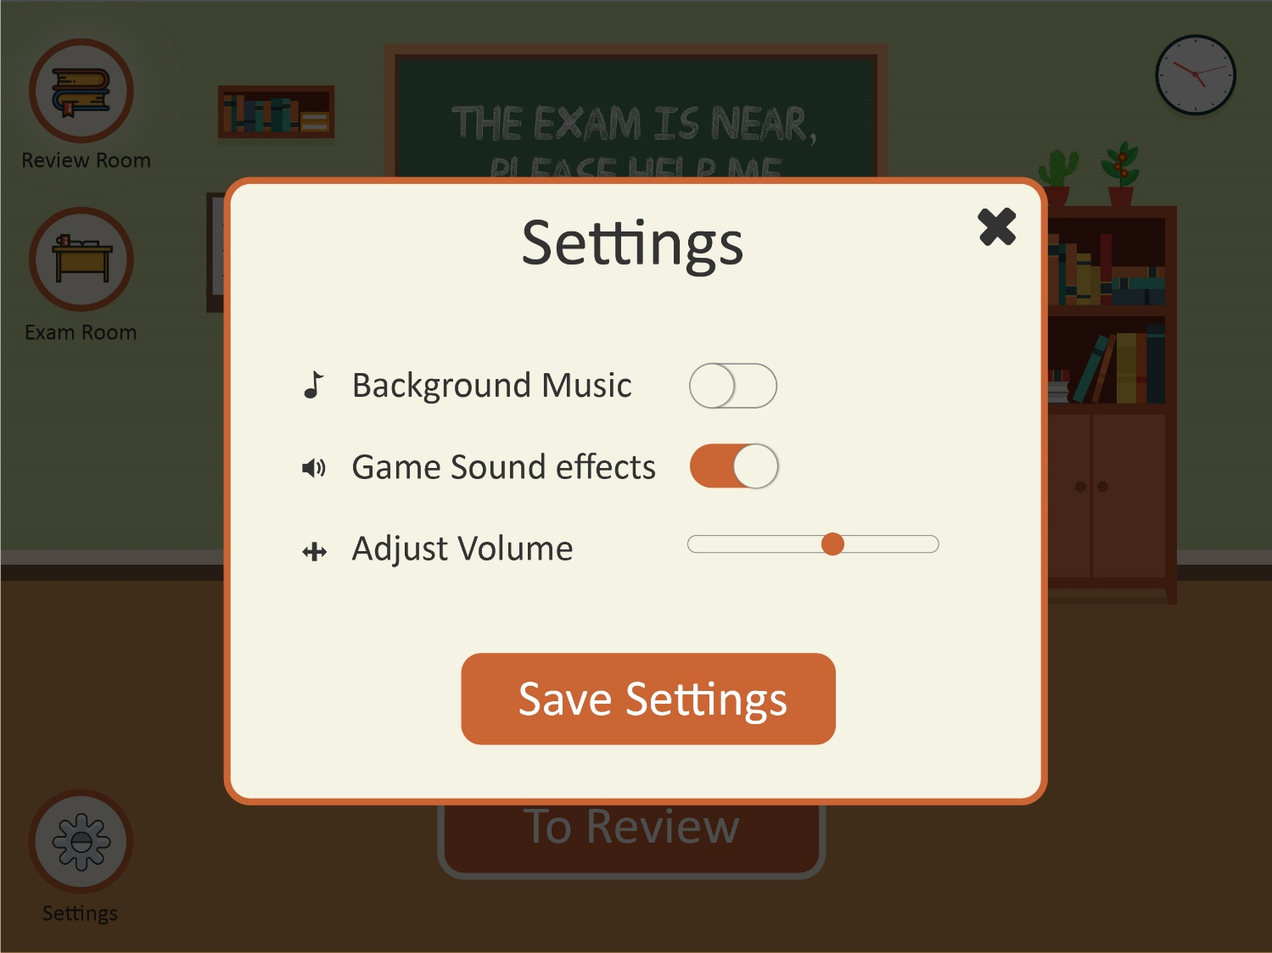
Functional module – settings
Set the background volume etc.

Slide 25
Students feedback

Slide 27
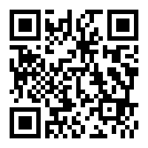
Thank you
Contact info :
Whatsapp : 90222772
Email : ccching@fssas.edu.hk
edwinccc718@gmail.com
Facebook : https://www.facebook.com/edwin.ching.98

